Slide 1
Figures draft for manuscript
The numbers are provisory

Slide 2
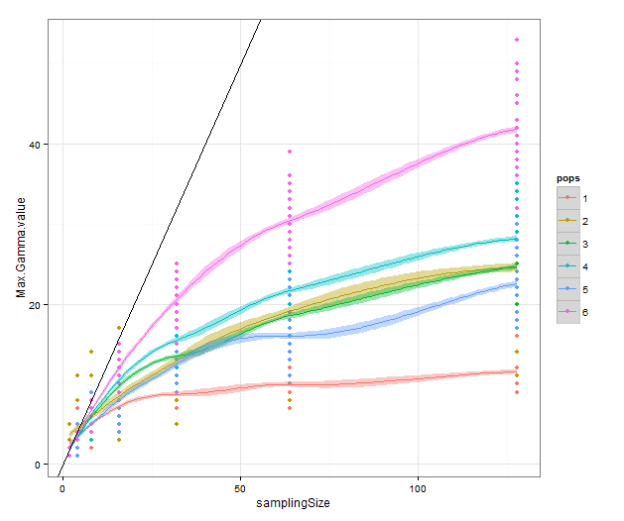
Figure 3a

Slide 3
Figure X2b

Slide 4
New Version!

Slide 5
Distribution of segregating sites in the simulated populations
Theta 2
Theta 10
Theta 20

Slide 6
Distribution of segregating sites in the simulated populations
Theta 2
Theta 10
Theta 20

Slide 7
Theta 2

Slide 8
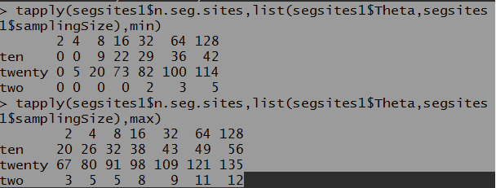

Slide 9
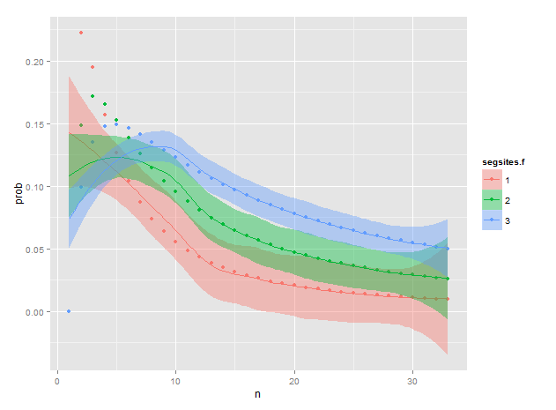
Theta two, n=2

Slide 10
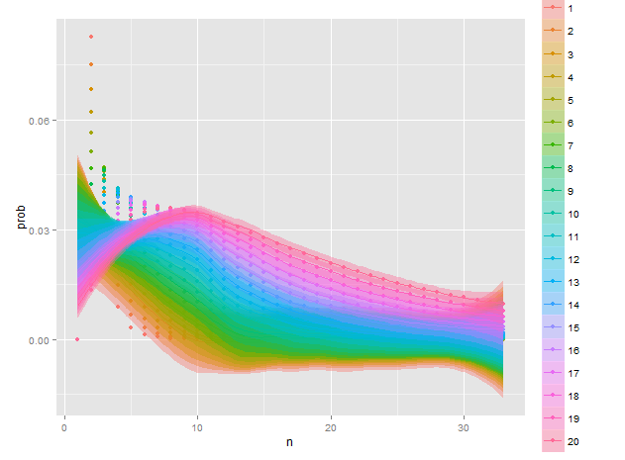
Theta ten, n=2

Slide 11
Maybe supp material??

Slide 12
Figure X1
120
100
80
Sample size (n)
60
40
20
0
1
2
3
4
5
6
0
5
10
15
20
25
30
Minimum number of haplotypes observed

